Slide 1


Indianapolis Local Education Alliance
August 20, 2025

Slide 2
Agenda
Welcome and Opening Remarks
PPHS – Charter School Facilities Presentation
TogetherEd – Charter School Facilities Presentation
ILEA Q&A – Charter Partners
IPS Facilities Presentation
ILEA Q&A – IPS
Public Comment
Closing and Next Steps
Notes:
MJH

Slide 3
Welcome and Opening Remarks
Notes:
Mayor Hogsett opens meeting, notes Barato Britt’s excused absence
Introduces Eddie Rangel (rahng-HELL), host at Adelante Schools
Emphasizes upcoming deep dive into facilities and adjusted public comment timing
Remarks from Eddie Rangel (rahng-HELL), Adelante Schools
(Up to 5 minutes about the school and its community)

Slide 4
Charter School Facilities
Notes:
Presenter 1: by Dr. Keeanna Warren (Purdue Polytechnic High Schools)
Presenter 2: Andy Seibert (TogetherEd)
Total time: ~25 minutes

Slide 5

Indianapolis Local Education Alliance Presentation
Keeanna Warren, PhD
August 20, 2025

Slide 6

About Us
Why We Exist
We are here to give each student access to their next giant leap—whether that means earning admission to Purdue University or pursuing a different path that reflects their unique goals and aspirations. At PPHS, we set high expectations and provide meaningful opportunities so every student can build a future that excites them.
How We Do It
We create relationship-driven schools where students are known, supported, and challenged. Our learning is personal, hands-on, and deeply connected to the real world—preparing students for successful independence beyond high school.
Our Commitment
We offer access and a clear pathway to Purdue University. Every student is known, valued, and empowered to take ownership of their learning and their future.

Slide 7
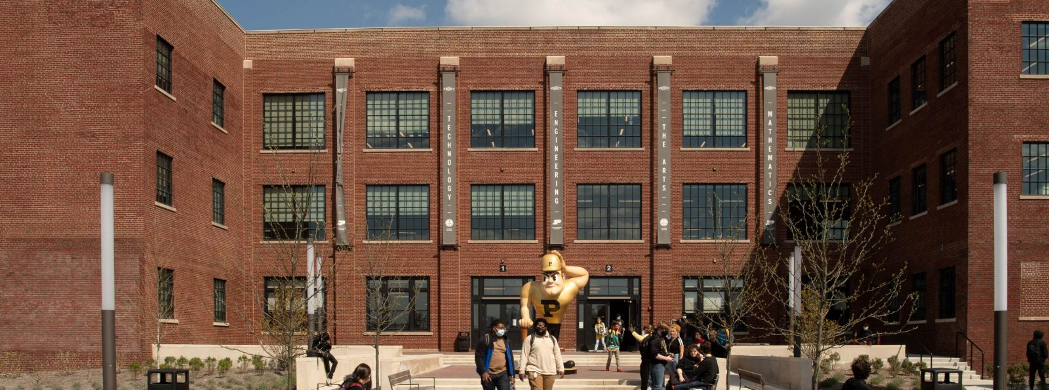
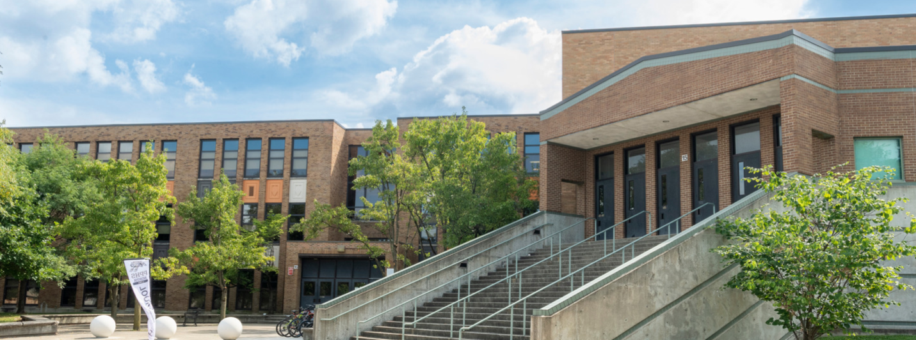
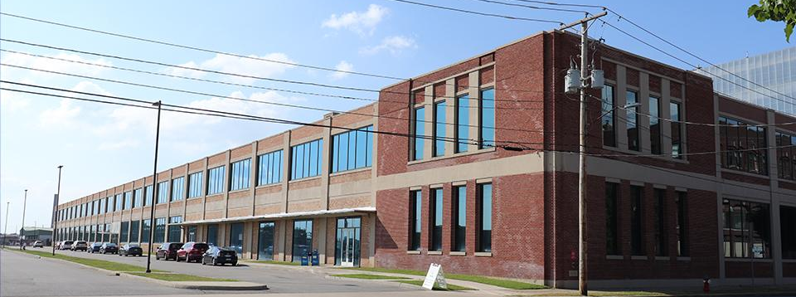
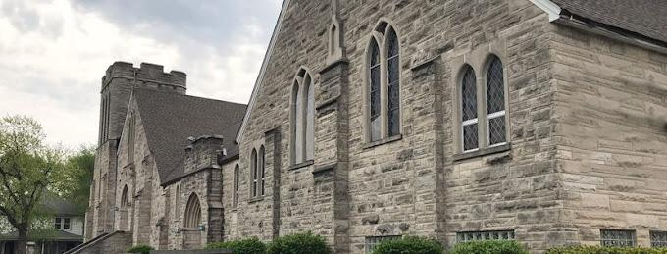
Our Schools
PPHS ENGLEWOOD
PPHS BROAD RIPPLE
PPHS SOUTH BEND
PPHS LAB
Notes:
We operate three schools, each serving distinct communities.
Our students come from across the region, with diverse backgrounds and needs.
Our focus today is Indianapolis, specifically two campuses that are central to this conversation.

Slide 8
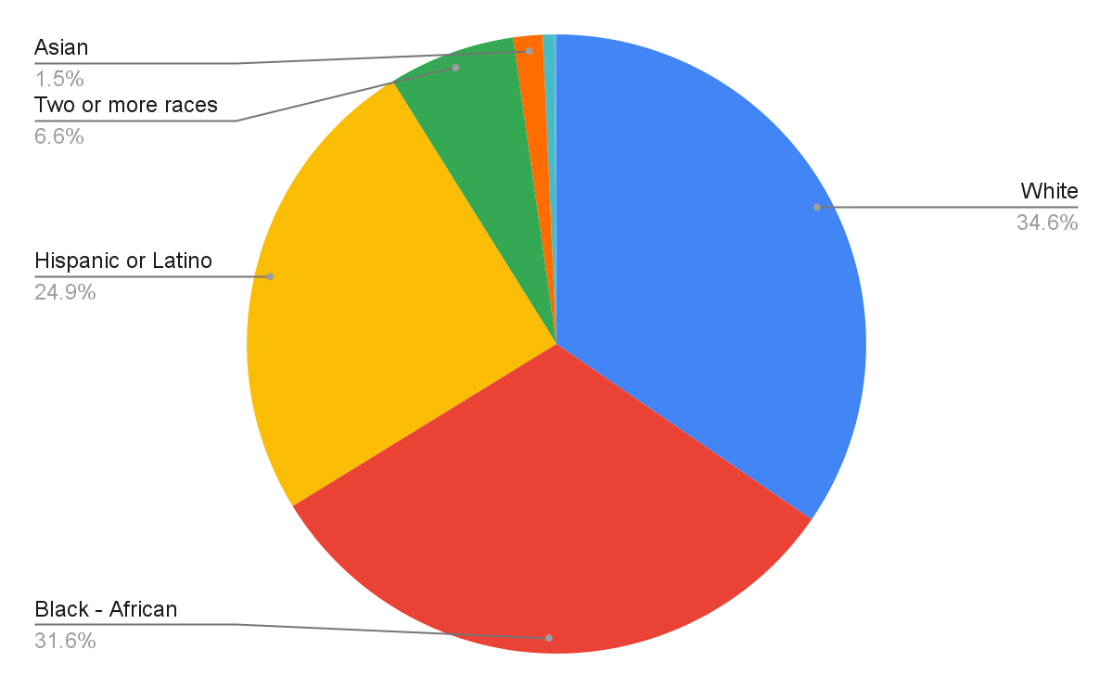
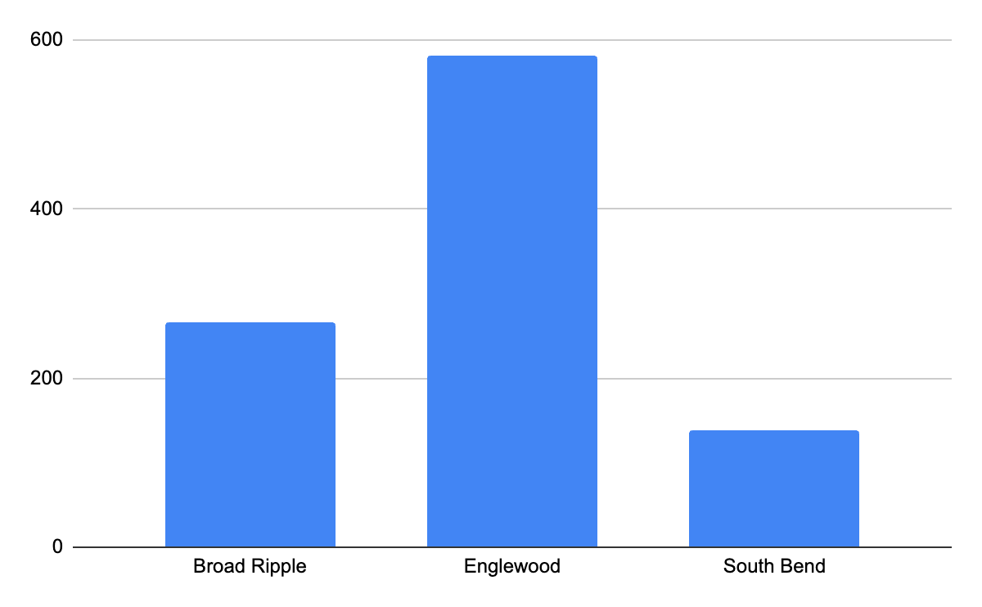
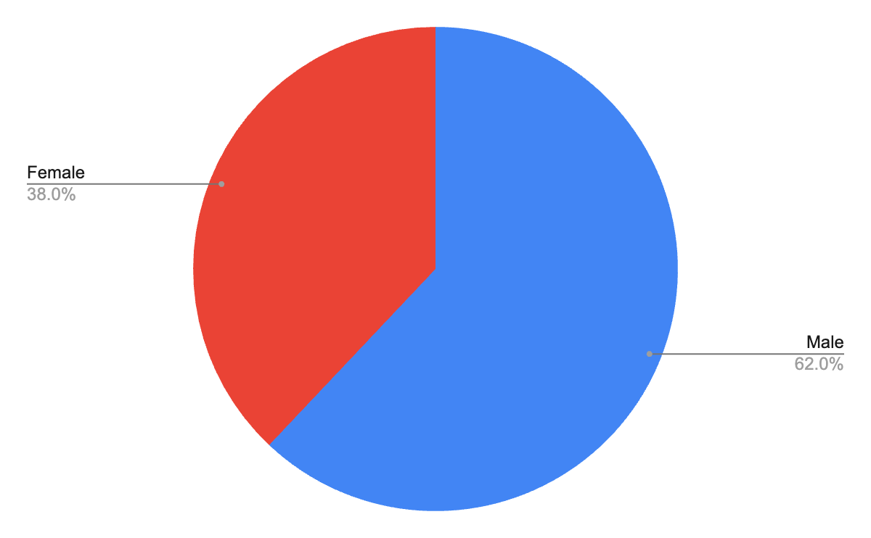
Enrollment
Total Enrollment
960
Enrollment by Race
Enrollment by School
Enrollment by Gender
Notes:
Keeanna. Talk about where we are at each school. Share gratitude for the Marketing & Communication support. We are hoping to engage in similar in the spring

Slide 9
Our Partnerships Matter
We are grateful to our facilities partners, Indianapolis Public Schools (IPS) and the Englewood Community Development Corporation (ECDC). Even with limited resources, both have consistently put students first—working alongside us to overcome challenges and strengthen our school community.

Slide 10
PPHS Schweitzer Center at Englewood

Slide 11
Facilities & Growth Overview
Our Flagship Campus
Opened in the 2017–18 school year at The Union 525 in downtown Indianapolis with 150 freshmen.
Outgrew the space at the end of the first year.
SY 2018–19 and 2019–20: Operated on the 4th floor of Circle Centre Mall while awaiting permanent facility.
2020–21: Moved into PR Mallory Campus as our long-term home.
Now serve 630 students in grades 9–12, with 99.52% residing in Marion County.
Multiple Buildings Supporting Students in a Vibrant, Partner-Rich Community
Mallory Building – 3029 E Washington St. | 53,154 SQFT | 25 classrooms (2nd & 3rd floors)
Bunker Building – 3 Moore Ave. | 12,752 SQFT | 3 classrooms
Cornerstone Church – 2837 E New York St. | 4,000 SQFT | 3 classrooms + 1 conference room

Slide 12
Strength & Opportunities
Embedded in a vibrant neighborhood with strong community engagement
Character-rich, PPHS-branded building fostering strong student and family identity
Seamless K–12 pathway with Paramount, including program collaborations
Space designed for our unique learning model
High transit access via IndyGo, with top student ridership and planned Blue Line
Large lot with future expansion potential
Scratch-cooking facilities for fresh meals
Rich history and abundant natural light
Fully equipped Makerspace, labs, and engineering facility with professional-grade tools for projects from design to large-scale builds
State champion, nationally recognized robotics team and 20+ IHSAA sports

Slide 13
Challenges & Constraints
Facilities cost
No ownership of primary property, limiting long-term investment
Aging infrastructure requiring significant maintenance (including a new roof)
No parking for staff, currently parking on a lot that needs remediation
Limited parking for guests
Located on busy East Washington Street with Indy go line under development
No auditorium/gathering space; some classrooms undersized for 28+ students
Indoor air quality issues and poor acoustics
No on-site sports facilities
Limited space for growth, with demand exceeding available capacity

Slide 14
PPHS Broad Ripple

Slide 15
Facilities & Growth Overview
Broad Ripple Campus
2019–20 and 2020–21 school years: Located at 1405 Broad Ripple Avenue, a two-story commercial building with limited classroom space.
Began with 65 students in grades 9–10 and quickly outgrew the space.
2021–22 school year: Operated across two locations — the original Broad Ripple site and the Storefront Theatre of Indianapolis, less than 2 miles apart — with students taking classes in both locations.
2022–23 school year: Began using space on the former Broad Ripple High School campus at 1115 Broad Ripple Ave., occupying the 3rd floor with 32 classrooms, an auxiliary gym, and a cafeteria.
Now serve about 220 students in grades 9–12, with 96.26% of Broad Ripple students residing in Marion County.
Multiple Facilities and Resources Supporting Students
Broad Ripple Building – 123,721 SQFT | 3rd floor with 32 classrooms, auxiliary gym, and cafeteria
Access to shared athletic fields, gymnasiums, and track through IPS

Slide 16
Strength & Opportunities
Limited access to sports facilities and a supportive neighborhood association
IPS covers maintenance
Space to grow and adapt programming
Benefits from IPS’s scale and systems, including expanded resources, purchasing power, and district-level operational support
A fully equipped Makerspace and engineering labs provide students with professional-grade tools and space for large-scale projects like go-kart design, robotics, and mechanical builds.
Growing IHSAA sports programs, including soccer, basketball, and track.

Slide 17
Challenges & Constraints
Shared facilities limit customization, impact scheduling, and require coordination with other school communities.
Limited use of athletic facilities
Building not designed for PPHS, creating layout inefficiencies.
3rd-floor location in an older building with no strong visual identity.
Lacks PPHS branding (e.g., crimson lockers instead of school colors).
Kitchen limited to warming only, not full cooking.
Ongoing Wi-Fi, heating, and cooling issues.
No ownership or full control over building use.
Limited parking.
Governance challenges for event and space usage.
Classrooms and shared spaces need upgrades to meet modern learning standards.
Notice of deficiency from OEI due to falling enrollment

Slide 18
Facilities Goals & Priorities
All students in Indianapolis have access to updated, high-quality spaces that meet their educational needs
Increased access to shared spaces and sports facilities
Updated, PPHS-branded campuses
Opportunity to lease or purchase our facilities if it becomes available

Slide 19

Thank you!!!
Notes:
Come back to the story from the beginning.

Slide 20

Indianapolis Local Education Alliance
August 20, 2025
Andy Seibert
TogetherEd

Slide 21
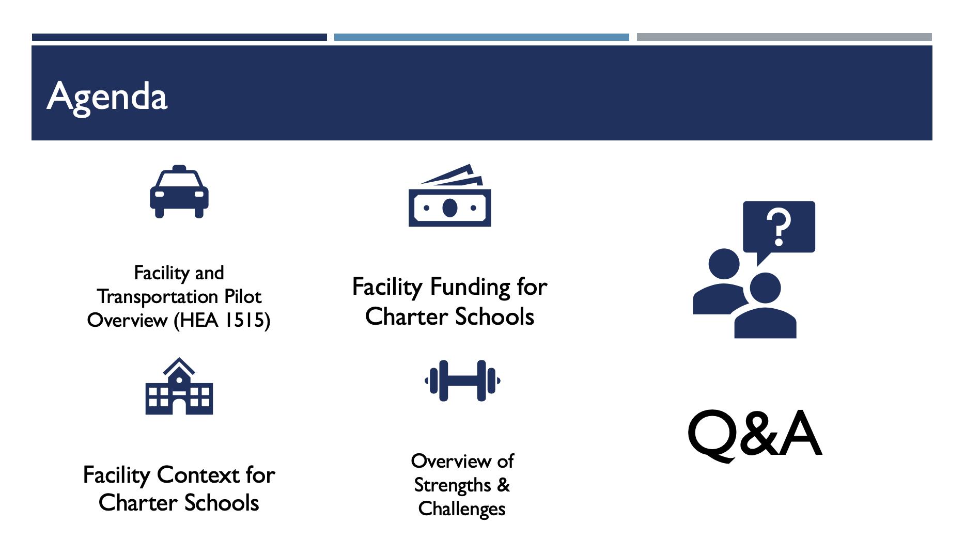
Agenda
Facility and Transportation Pilot Overview (HEA 1515)
Facility Funding for Charter Schools
Q&A
Overview of Strengths & Challenges
Facility Context for Charter Schools
Notes:
Slide 1 – Agenda
Overview of HEA 1515: ILEA + required Facilities & Transportation Pilots.
Facility context: funding inequities, utilization data, ownership/lease patterns.
Financial realities: $7,900 per pupil structural gap, millions in debt service.
Sector strengths: efficiency, adaptability, creative partnerships.
Persistent challenges: credit rating disadvantages, deferred maintenance, lease/debt obligations.
Close with opportunity: ILEA pilots as national model for collaboration.

Slide 22

Facilities and Transportation Pilot Overview
Established in 2025 through HEA 1515
Requires facilities assessments & long-term plan
Creates Facilities Pilot + Transportation Pilot
Built on collaboration: charter schools, community partners, non-public schools
54 schools engaged
21,650 students represented in the pilots
Notes:
IDOE is developing the application process for the following:
The Centralized School Facilities Pilot Program is established to provide:
Innovative approaches concerning the use, operation, and management of school facilities to promote enhanced learning environments;
Unique learning opportunities; and
Improved student academic and health outcomes
The Student Transportation Pilot Program is established to:
Allow for additional flexibility and creativity to accommodate transportation to and from school, out-of-school time opportunities, work based learning experiences, extracurricular activities; and specialized educational opportunities;
Improve safety and efficiency for students;
Increase collaboration between school corporations, schools, governmental entities,and community organizations;
Inspire opportunities for public-private partnerships or partnerships with other governmental entities or local nonprofit organizations.

Slide 23
Facilities and Transportation Timeline and Next Steps
Spring 2025 – Legislation Passed
• HEA 1515 establishes ILEA
• IDOE begins designing pilot application process
Summer/Fall 2025 – Pilot Development & Selection
• IDOE released application due 8/15
• Schools and partners engaged to discuss
transportation and facility assets and challenges
Indianapolis-based application submitted
IDOE will review and confirm recipients – October 2025
Winter 2026 – Pilot Launch
• Short and medium term collaboration and
innovation pursued by pilot coalition
2026–2027 – Ongoing Evaluation
• Data collection on efficiency, cost savings, and
student impact
• Mid-course adjustments informed by early
results
2028 – Expansion / Policy Consideration
• Legislative review of pilot outcomes
• Potential to sustain and/or expand efforts

Slide 24
Facility Context for Charter Schools
Charter School/Network-Owned 23 schools (8 Innovation, 15 Independent) Stability, equity, control Debt and financing challenges Full maintenance & compliance responsibility | Lease Arrangements Common entry point for new/small schools Strong options if speed/flexible launches are a priority No equity, subject to owner’s plans/intended use
IPS-Owned (Innovation Network) 67% of Innovation students (7,400) in IPS facilities Established buildings with more space, higher quality common spaces (i.e. gyms, cafeterias, Lower direct costs because of IPS in-kind supports | Co-Located/Shared Space shared with IPS, other charter schools, or community partners Cost-efficient, community integration Scheduling conflicts, culture inconsistency, risk of displacement depending on ownership structure
Notes:
Facility Contexts
a. Charter Network-Owned Facilities
· 8 Innovation charters and 15 independent charters own their buildings.
· Advantages: stability, ability to modify space, build equity.
· Challenges: high upfront costs, full responsibility for maintenance, limited access to low-interest financing.
b. Lease Arrangements (Independent & Some Innovation Charters)
· Common for new or smaller schools. Offers flexibility but carries higher long-term costs and less stability.
· Examples: ACE Preparatory Academy (leased, capacity 420, enrollment 131) or Purdue Polytechnic HS Englwood (leased, 465 capacity, 600 enrollment—over-enrolled).
· Lease obligations can be significant: e.g., ACE Prep carried $3.2M remaining lease obligation as of 2023–24.
c. IPS-Owned Buildings (Innovation Network Charter Schools)
· Roughly 67% of Innovation Network charter students (7,400 students) are in IPS-owned facilities.
· More than half also use IPS-provided transportation, custodial, and security services. IPS says they spent $38 million in 2023–24 on facility and security for innovation schools, supported by the $410M 2023 referendum.
· Advantages: reduced direct facility costs (often 20–25% in-kind support of reported expenses).
· Constraints: less autonomy over space modifications, reliance on district priorities.
d. Co-Location & Shared Spaces
· Some schools share facilities with other charters, IPS, or community organizations.
· Benefits: cost efficiency and community integration.
· Risks: scheduling conflicts, limited autonomy, potential displacement if district priorities shift.

Slide 25
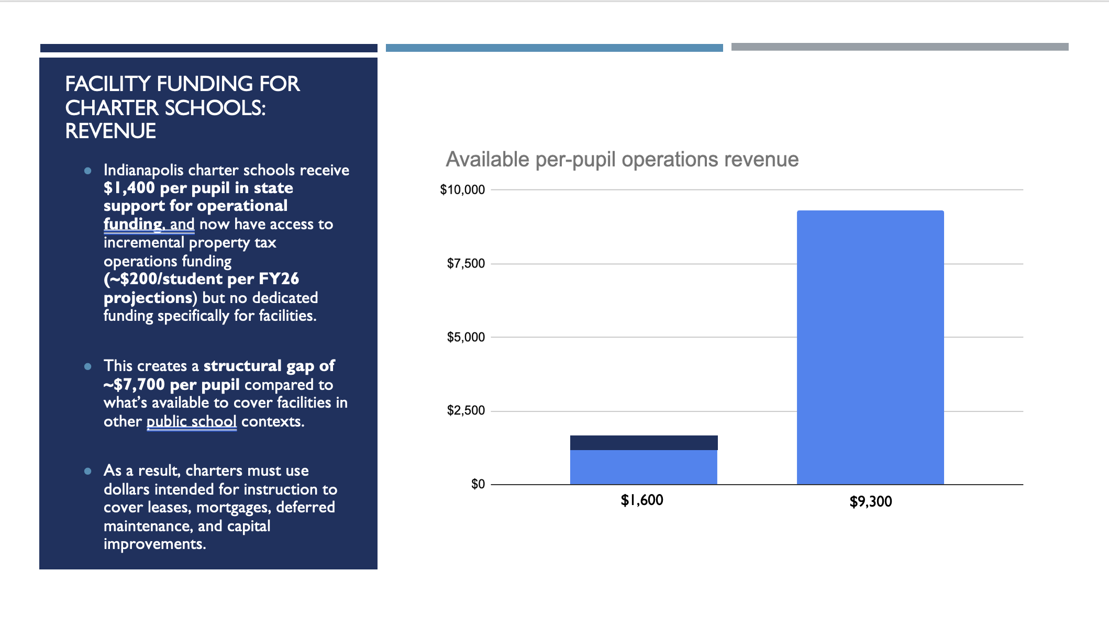
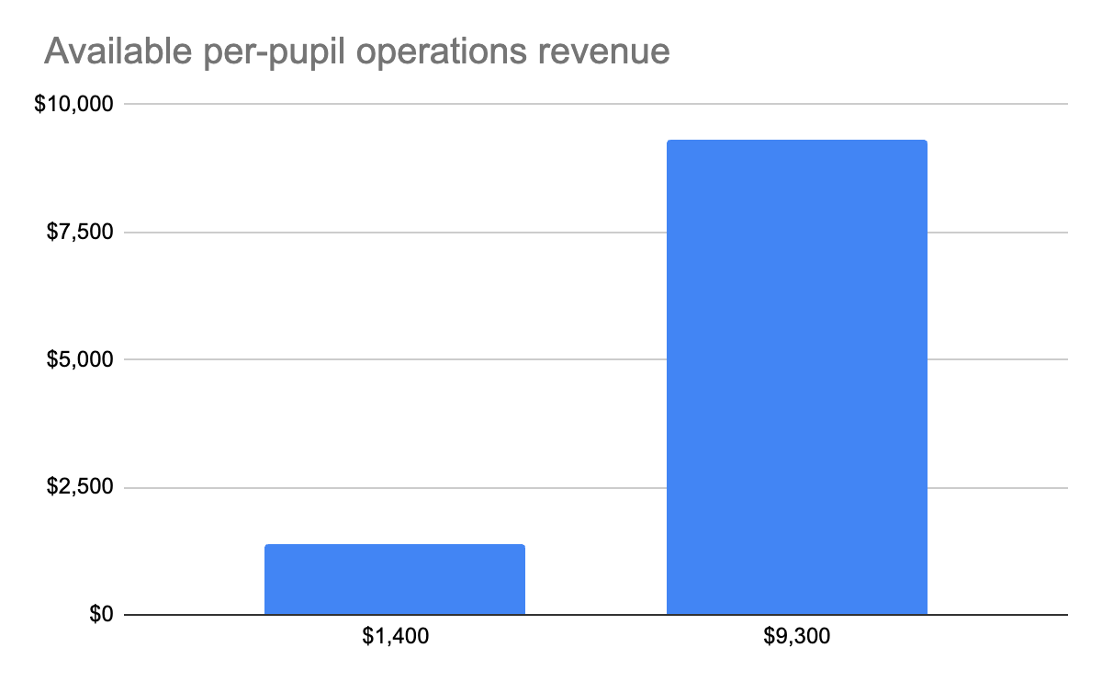
Facility Funding for Charter Schools: Revenue
Indianapolis charter schools receive $1,400 per pupil in state support for operational funding, and now have access to incremental property tax operations funding (~$200/student per FY26 projections) but no dedicated funding specifically for facilities.
This creates a structural gap of ~$7,700 per pupil compared to what’s available to cover facilities in other public school contexts.
As a result, charters must use dollars intended for instruction to cover leases, mortgages, deferred maintenance, and capital improvements.
$1,600
$9,300

Slide 26
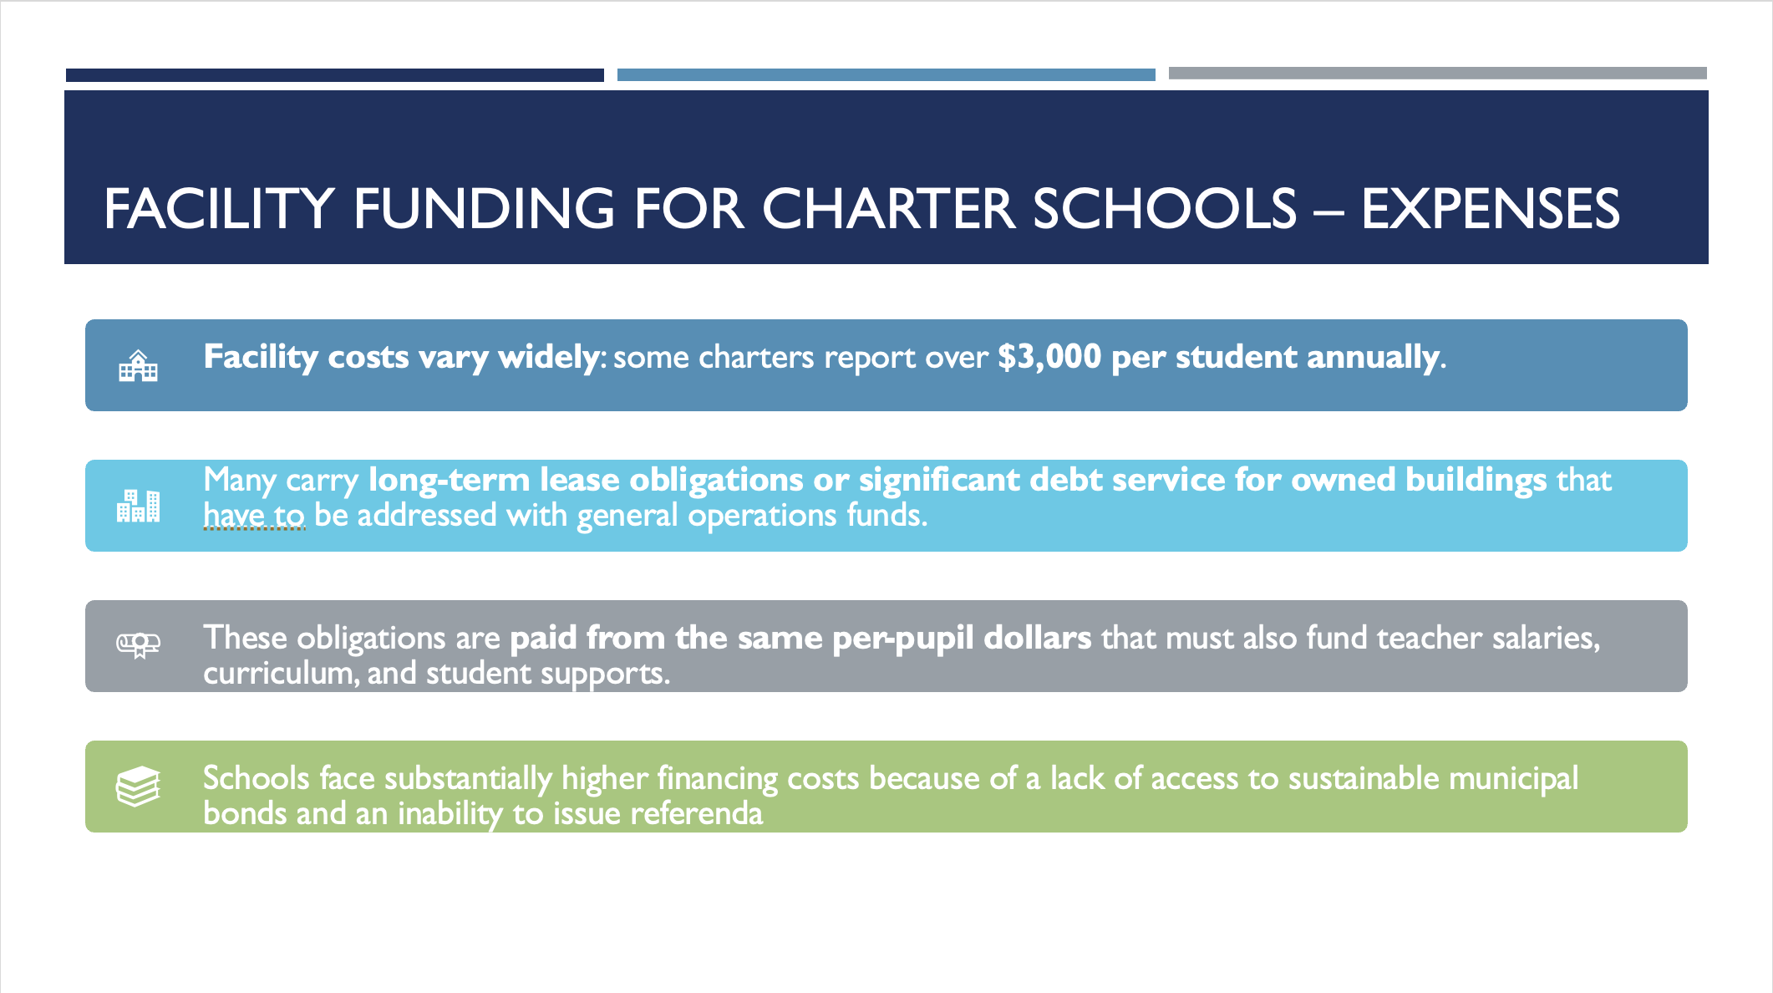
Facility Funding for Charter Schools – Expenses
Facility costs vary widely: some charters report over $3,000 per student annually.
Many carry long-term lease obligations or significant debt service for owned buildings that have to be addressed with general operations funds.
These obligations are paid from the same per-pupil dollars that must also fund teacher salaries, curriculum, and student supports.
Schools face substantially higher financing costs because of a lack of access to sustainable municipal bonds and an inability to issue referenda

Slide 27
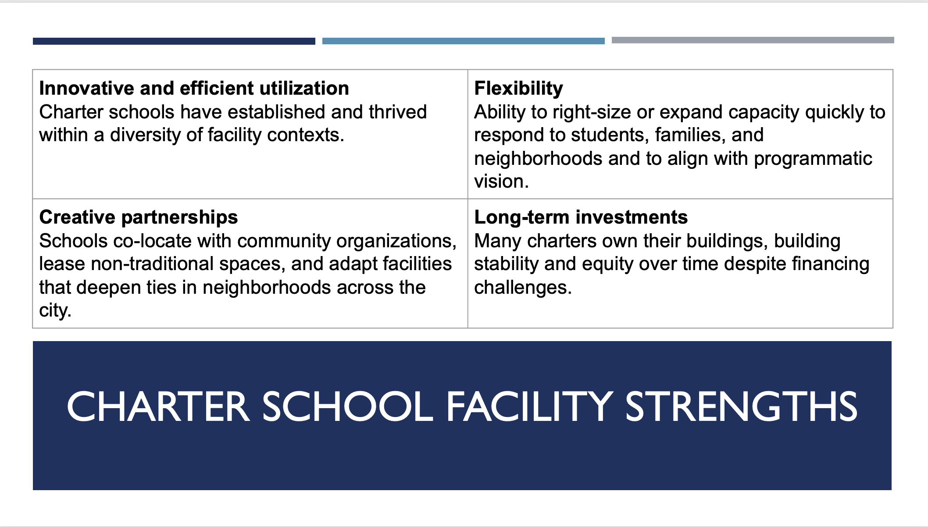
Charter School Facility STRENGTHS
Innovative and efficient utilization Charter schools have established and thrived within a diversity of facility contexts. | Flexibility Ability to right-size or expand capacity quickly to respond to students, families, and neighborhoods and to align with programmatic vision.
Creative partnerships Schools co-locate with community organizations, lease non-traditional spaces, and adapt facilities that deepen ties in neighborhoods across the city. | Long-term investments Many charters own their buildings, building stability and equity over time despite financing challenges.
Notes:
Facility Contexts
a. Charter Network-Owned Facilities
· 8 Innovation charters and 15 independent charters own their buildings.
· Advantages: stability, ability to modify space, build equity.
· Challenges: high upfront costs, full responsibility for maintenance, limited access to low-interest financing.
b. Lease Arrangements (Independent & Some Innovation Charters)
· Common for new or smaller schools. Offers flexibility but carries higher long-term costs and less stability.
· Examples: ACE Preparatory Academy (leased, capacity 420, enrollment 131) or Purdue Polytechnic HS Englwood (leased, 465 capacity, 600 enrollment—over-enrolled).
· Lease obligations can be significant: e.g., ACE Prep carried $3.2M remaining lease obligation as of 2023–24.
c. IPS-Owned Buildings (Innovation Network Charter Schools)
· Roughly 67% of Innovation Network charter students (7,400 students) are in IPS-owned facilities.
· More than half also use IPS-provided transportation, custodial, and security services. IPS says they spent $38 million in 2023–24 on facility and security for innovation schools, supported by the $410M 2023 referendum.
· Advantages: reduced direct facility costs (often 20–25% in-kind support of reported expenses).
· Constraints: less autonomy over space modifications, reliance on district priorities.
d. Co-Location & Shared Spaces
· Some schools share facilities with other charters, IPS, or community organizations.
· Benefits: cost efficiency and community integration.
· Risks: scheduling conflicts, limited autonomy, potential displacement if district priorities shift.

Slide 28
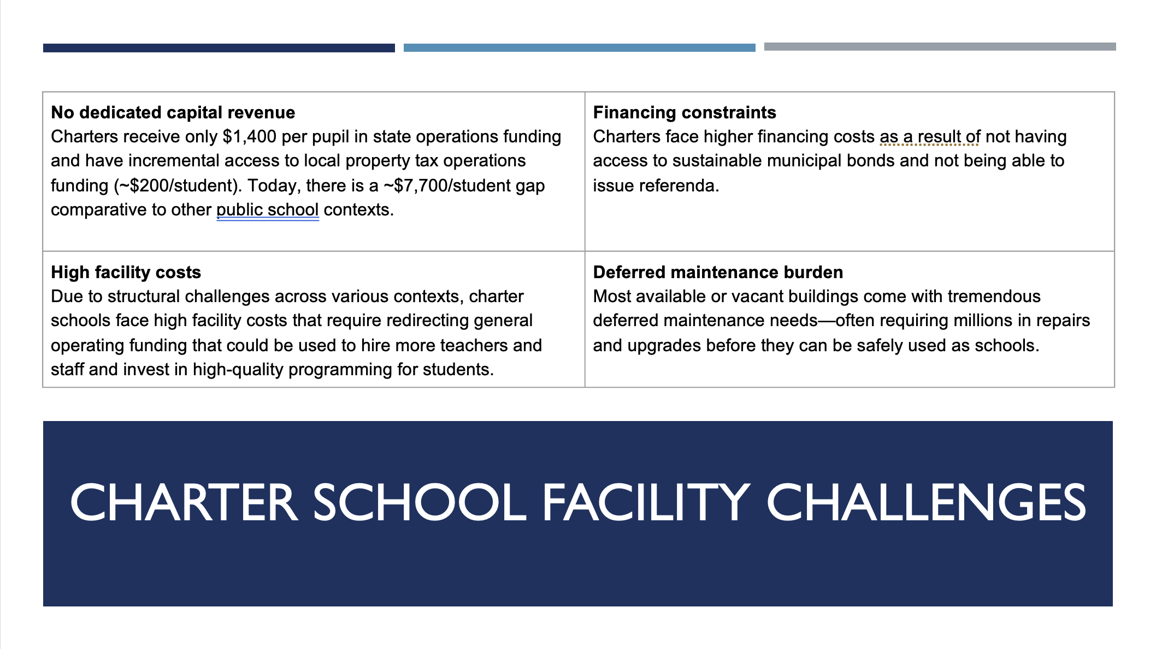
Charter School Facility Challenges
No dedicated capital revenue Charters receive only $1,400 per pupil in state operations funding and have incremental access to local property tax operations funding (~$200/student). Today, there is a ~$7,700/student gap comparative to other public school contexts. | Financing constraints Charters face higher financing costs as a result of not having access to sustainable municipal bonds and not being able to issue referenda.
High facility costs Due to structural challenges across various contexts, charter schools face high facility costs that require redirecting general operating funding that could be used to hire more teachers and staff and invest in high-quality programming for students. | Deferred maintenance burden Most available or vacant buildings come with tremendous deferred maintenance needs—often requiring millions in repairs and upgrades before they can be safely used as schools.
Notes:
Facility Contexts
a. Charter Network-Owned Facilities
· 8 Innovation charters and 15 independent charters own their buildings.
· Advantages: stability, ability to modify space, build equity.
· Challenges: high upfront costs, full responsibility for maintenance, limited access to low-interest financing.
b. Lease Arrangements (Independent & Some Innovation Charters)
· Common for new or smaller schools. Offers flexibility but carries higher long-term costs and less stability.
· Examples: ACE Preparatory Academy (leased, capacity 420, enrollment 131) or Purdue Polytechnic HS Englwood (leased, 465 capacity, 600 enrollment—over-enrolled).
· Lease obligations can be significant: e.g., ACE Prep carried $3.2M remaining lease obligation as of 2023–24.
c. IPS-Owned Buildings (Innovation Network Charter Schools)
· Roughly 67% of Innovation Network charter students (7,400 students) are in IPS-owned facilities.
· More than half also use IPS-provided transportation, custodial, and security services. IPS says they spent $38 million in 2023–24 on facility and security for innovation schools, supported by the $410M 2023 referendum.
· Advantages: reduced direct facility costs (often 20–25% in-kind support of reported expenses).
· Constraints: less autonomy over space modifications, reliance on district priorities.
d. Co-Location & Shared Spaces
· Some schools share facilities with other charters, IPS, or community organizations.
· Benefits: cost efficiency and community integration.
· Risks: scheduling conflicts, limited autonomy, potential displacement if district priorities shift.

Slide 29
Partnership Gratitude
Q&A

Slide 30
ILEA Q&A
Notes:
Discussion and questions with Charter presenters
Total time: ~15 minutes

Slide 31
IPS Facilities
Notes:
Superintendent Johnson introduces IPS presenter
Presentation covers IPS facility data and strategy (~25 minutes)

Slide 32
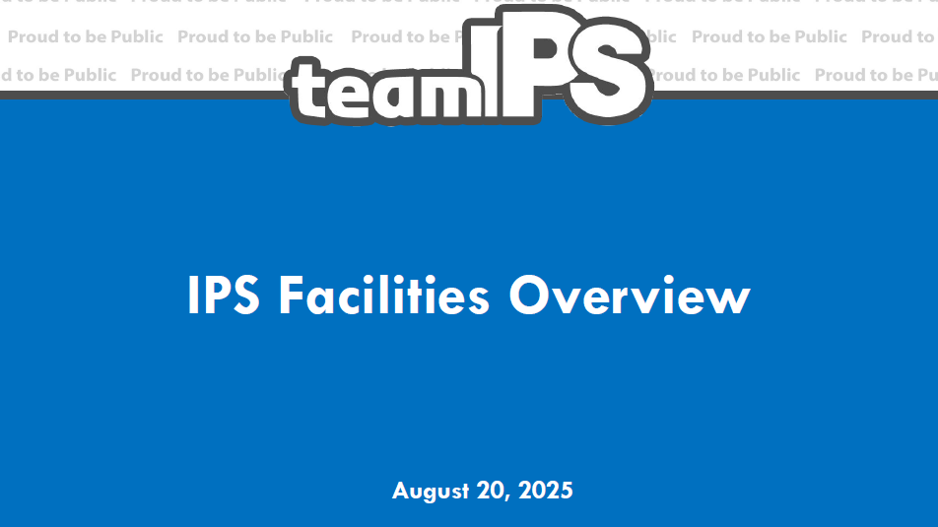

Slide 33
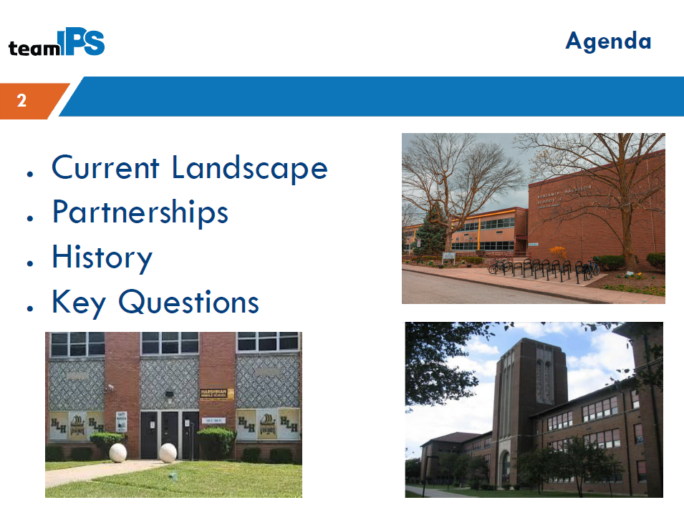

Slide 34
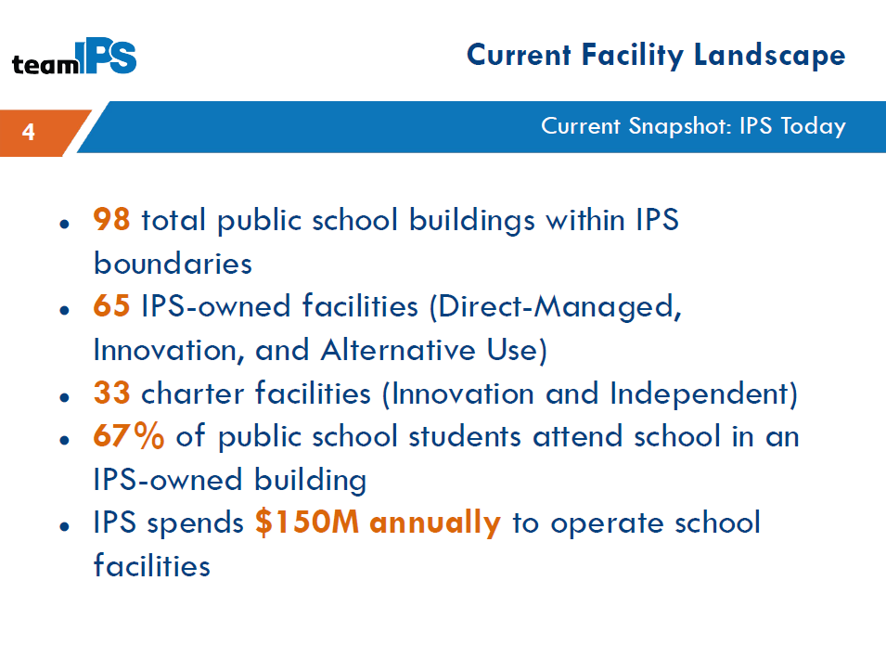

Slide 35
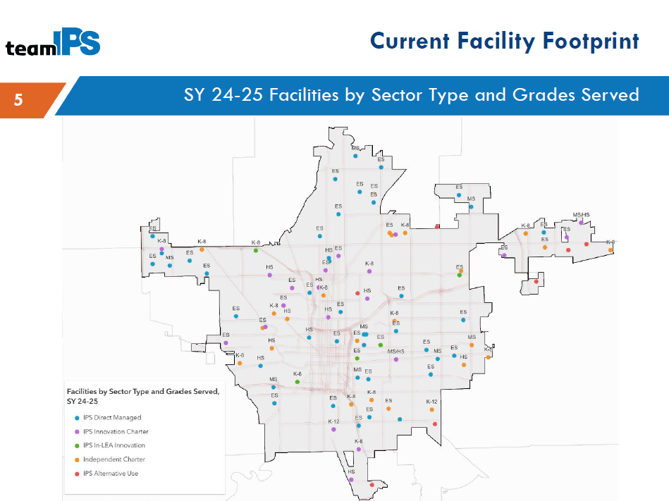

Slide 36
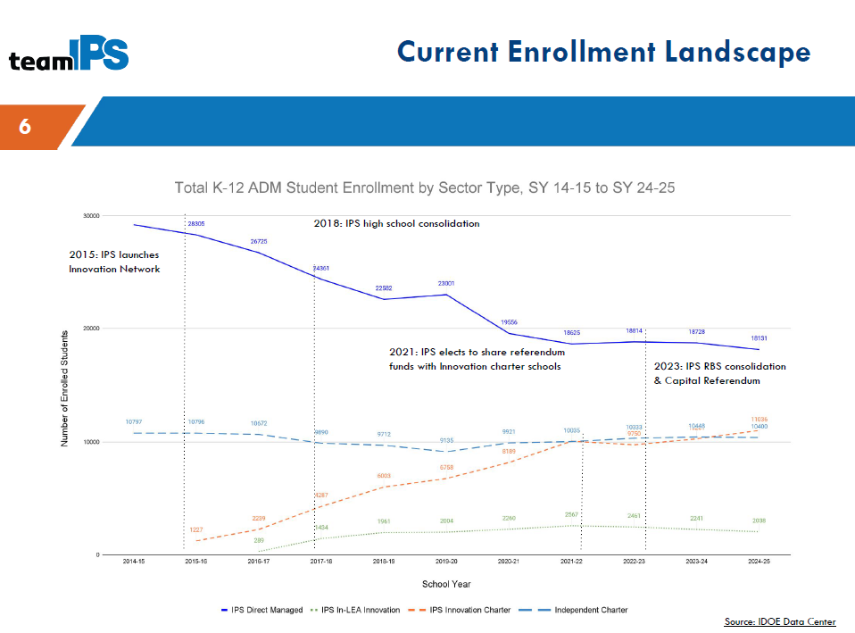

Slide 37
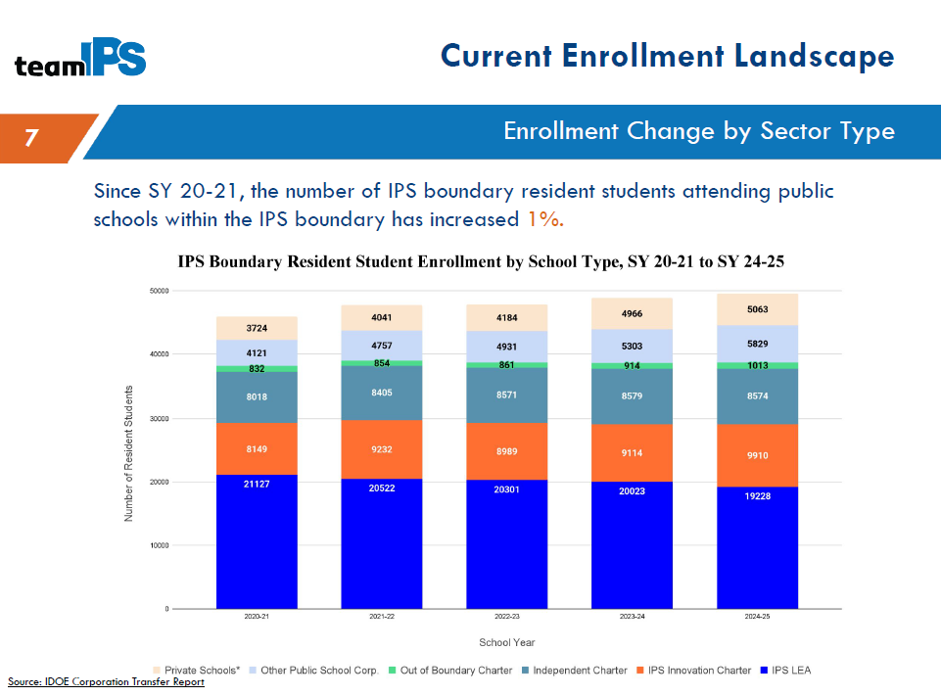

Slide 38
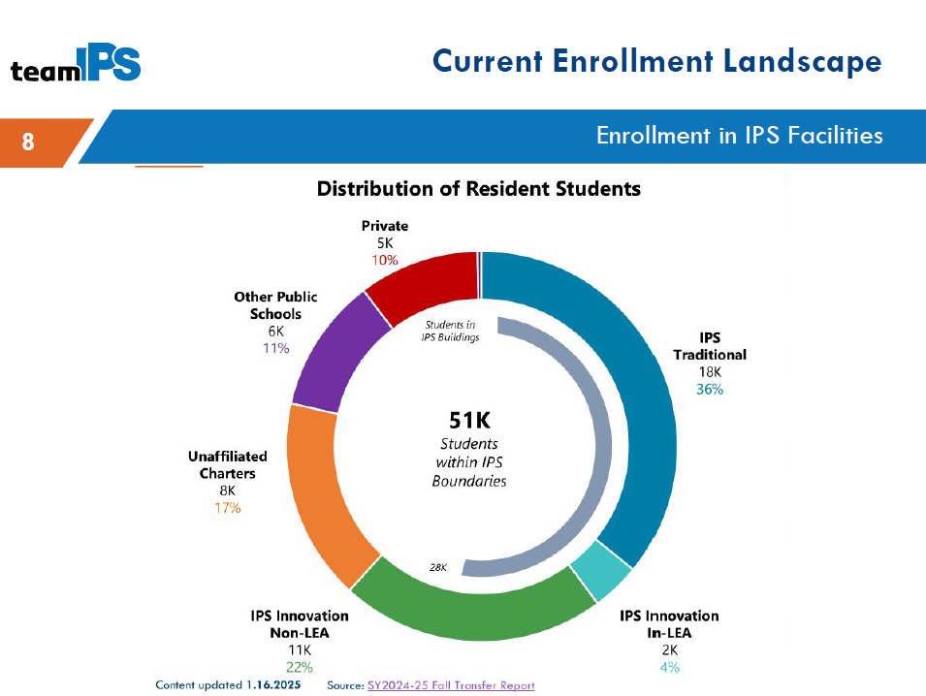

Slide 39
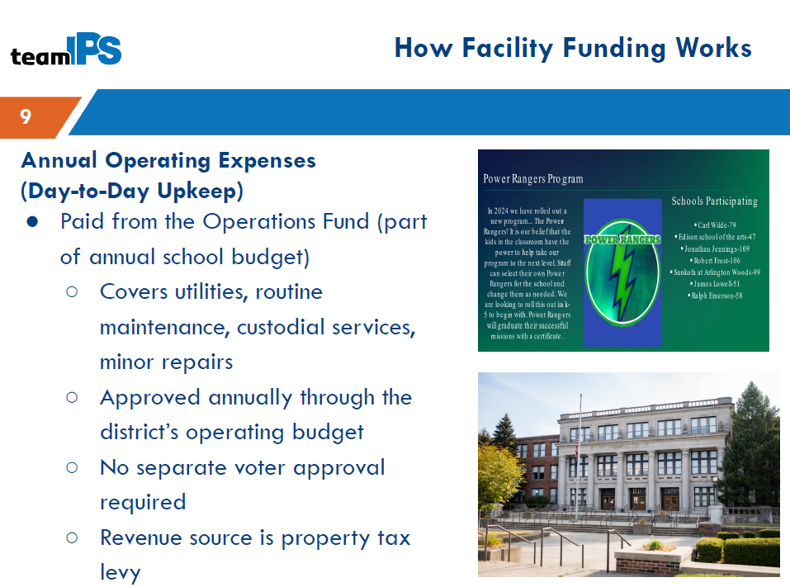

Slide 40
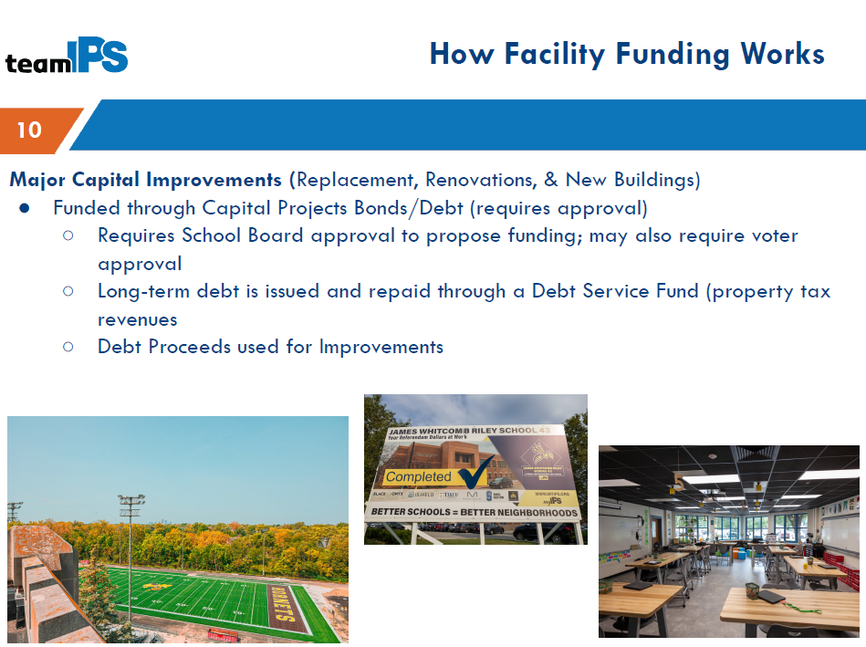

Slide 41
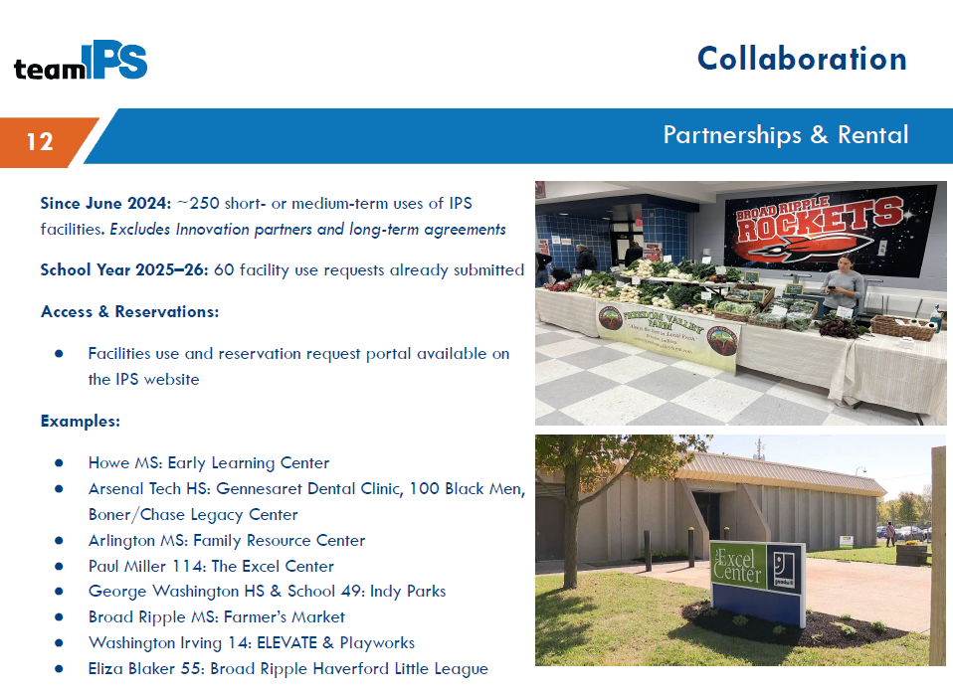

Slide 42
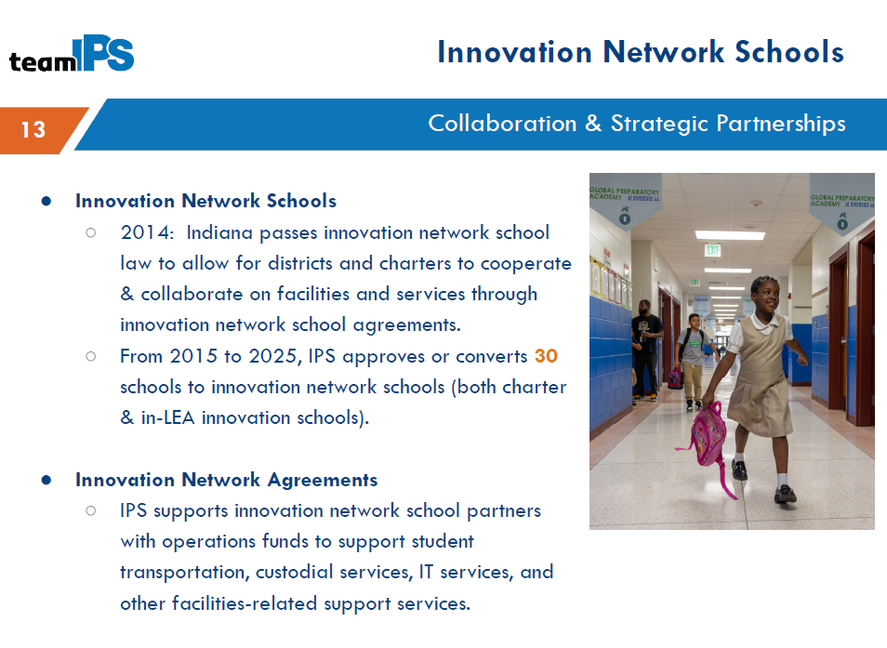

Slide 43
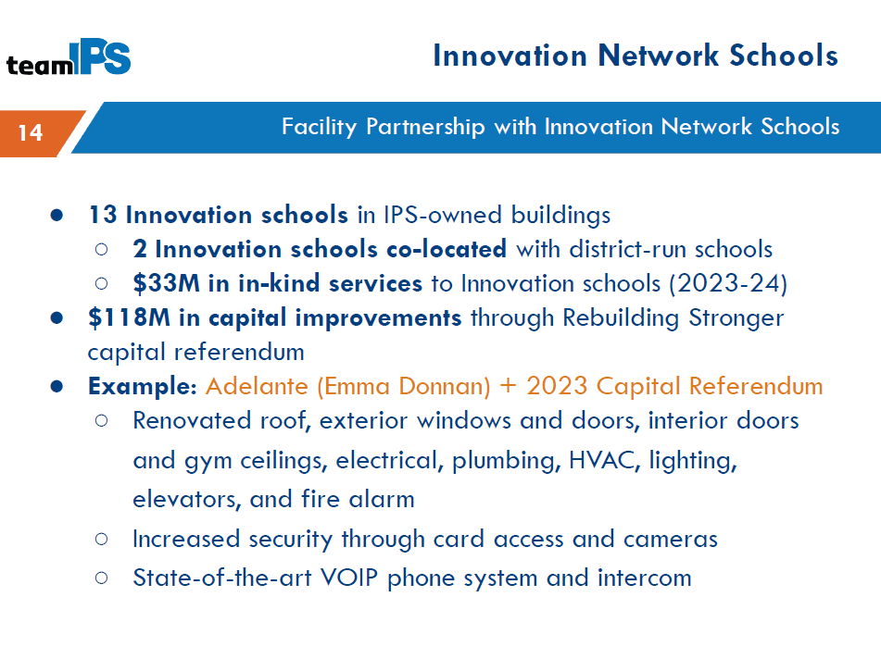

Slide 44
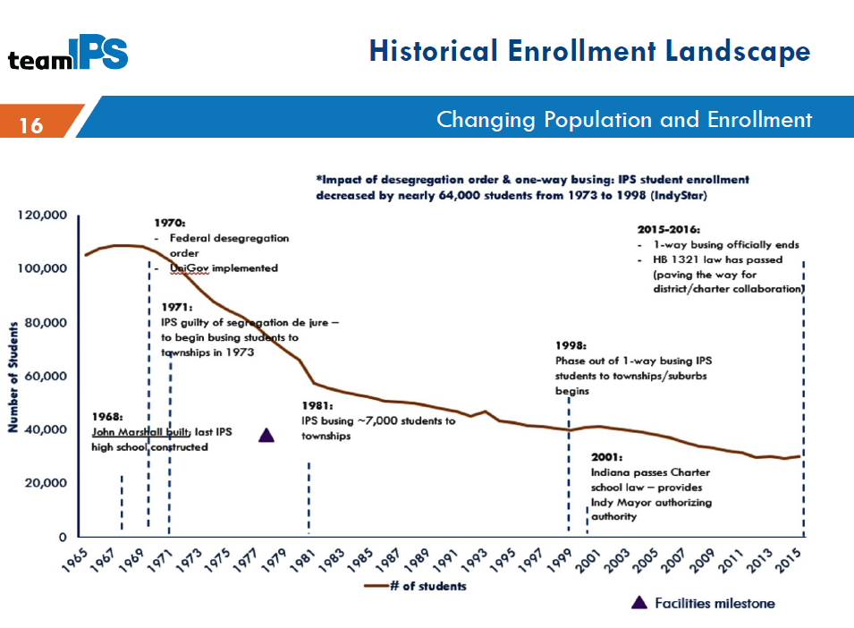

Slide 45
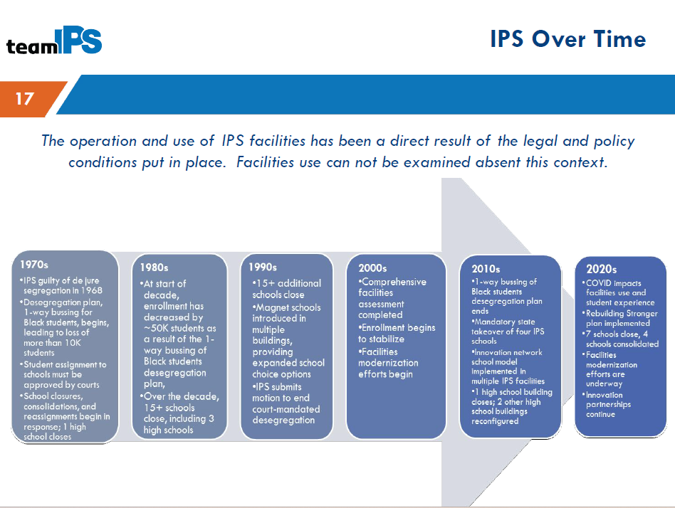

Slide 46
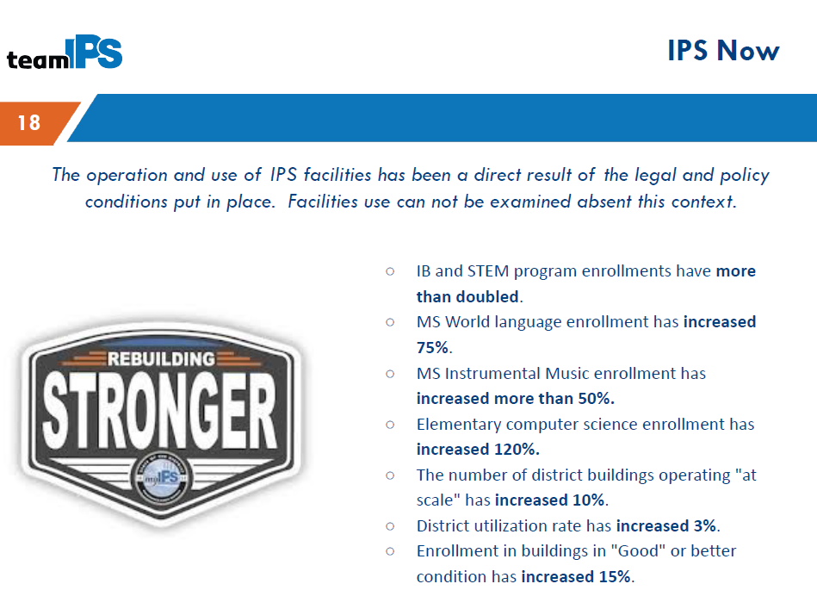

Slide 47
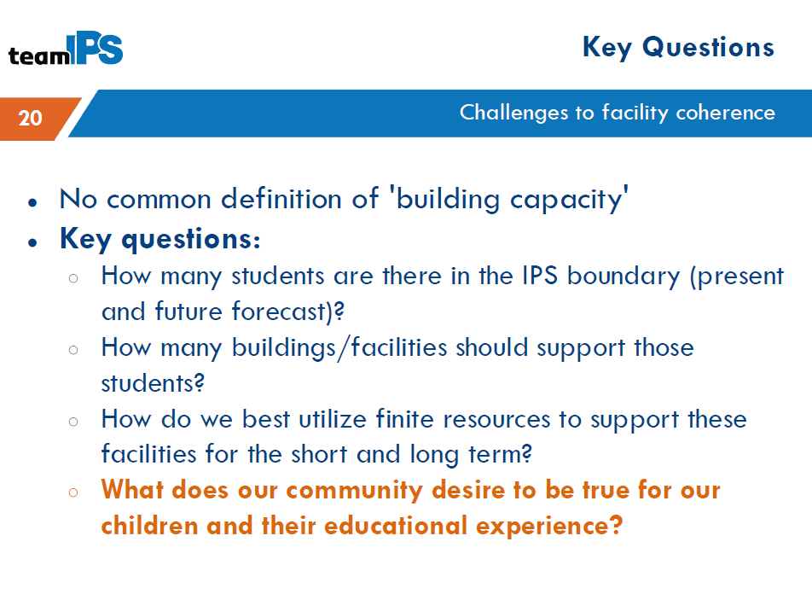

Slide 48


Slide 49
ILEA Q&A
Notes:
Discussion and questions with IPS presenters
Total time: ~15 minutes

Slide 50
Public Comment Procedure
For everyone to have a fair chance to speak and be heard, please observe the following rules:
First, each speaker will be limited to 1 minute. When the timer sounds, please conclude your statement.
Second, please ensure comments reasonably relate to the work of the ILEA and address the alliance as a whole. Tonight, comments should focus on facilities.
Finally, please avoid repeating what a prior speaker has said so that we may hear from as many people as possible.
Notes:
Shaina

Slide 51
Public Comment
Notes:
Shaina

Slide 52
Tentative ILEA Roadmap
July/August: Review current landscape, identify priority data around academics, transportation, facilities, etc.
September/October: Issues deep dive to identify potential challenges and consider draft recommendations
November/December: Continued analysis and refinement of recommendations
December: ILEA adopts final recommendations. Plan submitted to state and local leaders by 12/31.
Notes:
MJH

Slide 53
Closing
Next steps include:
Transportation focus coming in September
Data collection and analysis ongoing
Next Meeting:
6 p.m., Wednesday, Sept. 24, 2025.
Details and upcoming meeting schedule available at https://www.indy.gov/activity/indianapolis-local-education-alliance
Contact ILEA@Indy.gov or IPSExternalAffairs@myips.org with questions or comments.
Notes:
MJH

